Slide 1

CREDIT CARD APPROVAL PREDICTION MODEL
Company : SSJ IT Solutions Pvt. Ltd.
Domain : Machine Learning
Name : Jeeva K
Intern ID : ML01006

Slide 2
Check the Customer’s eligibility to get an approval for Credit Card using different Machine Learning Algorithms. The Dataset containing 18 different Columns There are,
Application id
first_name
last_name
email
gender
address
age
tdecision
empstaus
ExCus (Customer in Past)
Source
Salary
ExDebt (Liability)
Booking
INT_ID
Prev_ID
AGT_ID
Booking_Amt
So, we have to analyze data and meaningful insights from it

Slide 3
DATA PREPROCESSING TECHNIQUES
Missing values
Data Cleaning
Extract Features
Feature Encoding
Label Encoding
Handle Outliers
Separate Independent and dependent Features then Select
To Find Best Feature

Slide 4
DATA EXPLORATION
Data exploration is a key aspect of data analysis and model building. Without spending significant time on understanding the data and its patterns one cannot expect to build efficient predictive models. Data exploration takes major chunk of time in a data science project comprising of data cleaning and preprocessing

Slide 5
DATA VISUALIZATION
Data visualization is the graphical representation of data in order to explore and visualize data to uncover insights from the start or identify areas or patterns to dig into more.
Using interactive dashboards and point-and-click data exploration, users can better understand the bigger picture and get to insights faster.

Slide 6
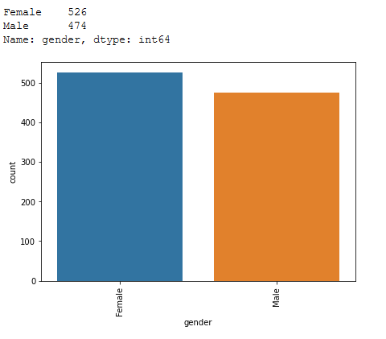
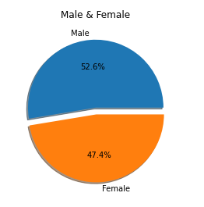
GENDER ANALYSIS

Slide 7
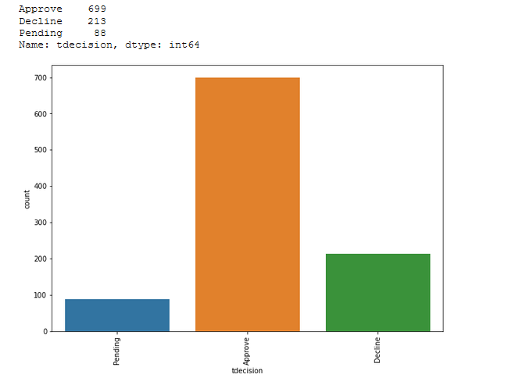
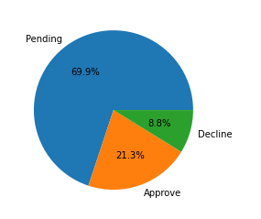
DECISION ANALYSIS

Slide 8
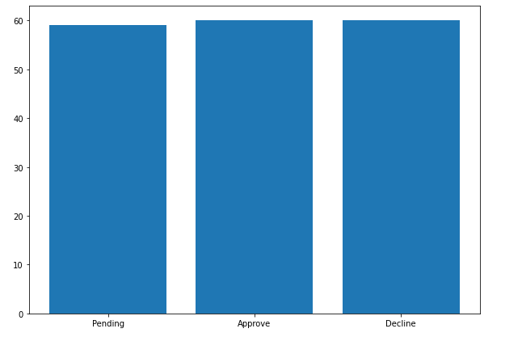
DECISION BASED ON AGE

Slide 9
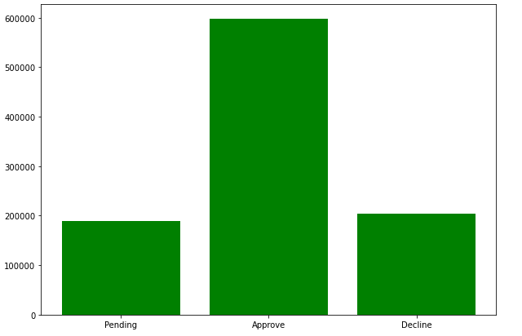
DECISION BASED ON SALARY

Slide 10
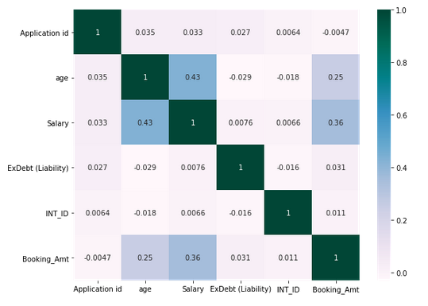
CORRELATION MATRIX

Slide 11
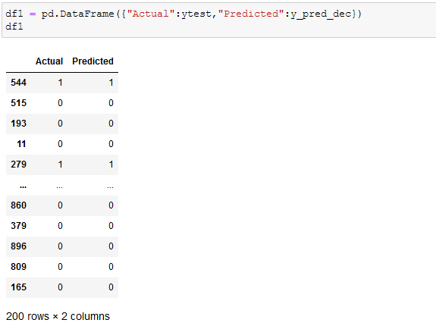
DECISIONTREECLASSIFIER
Decision Tree use to solve different kind of problems like Regression and Classification and It's a Rule based kind of thing. Decision Tree is according to divide into two variables and it's just making decision

Slide 12
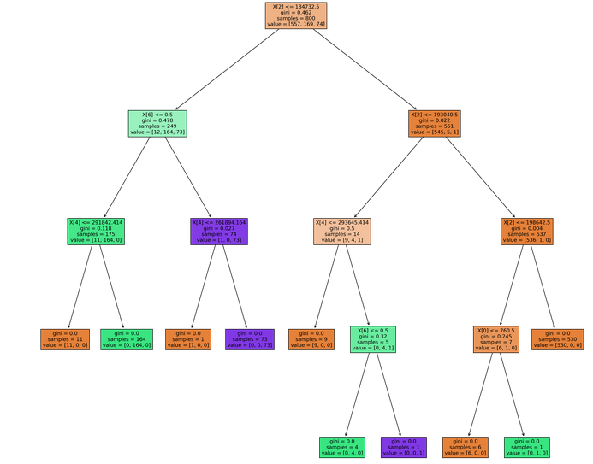
STEP BY STEP PROCESS

Slide 13
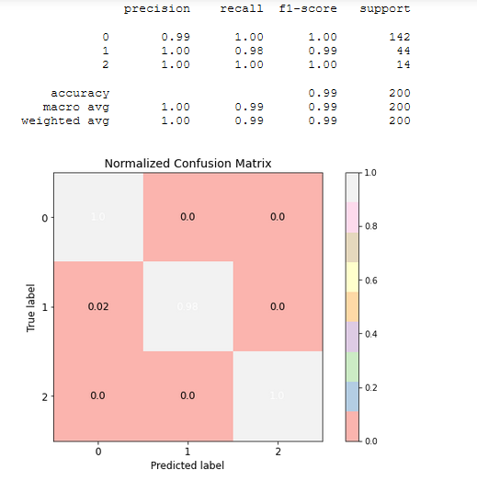
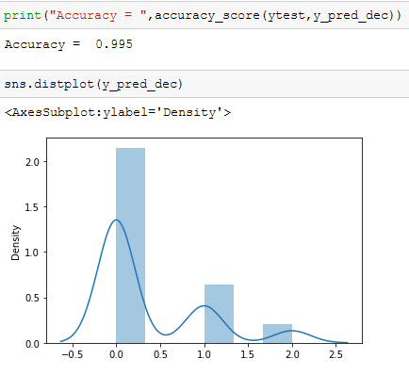
NORMALIZED CONFUSION MATRIX AND ACCURACY

Slide 14
BAGGINGCLASSIFIER
A Bagging classifier is an ensemble meta-estimator that fits base classifiers each on random subsets of the original dataset and then aggregate their individual predictions (either by voting or by averaging) to form a final prediction. Such a meta-estimator can typically be used as a way to reduce the variance of a black-box estimator (e.g., a decision tree), by introducing randomization into its construction procedure and then making an ensemble out of it

Slide 15
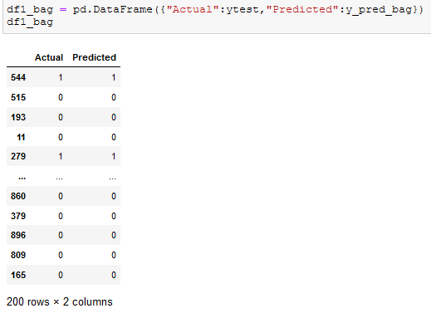
ACTUAL AND PREDICTED DATA

Slide 16
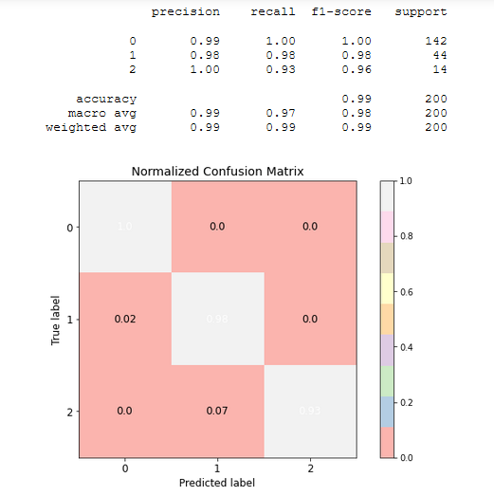

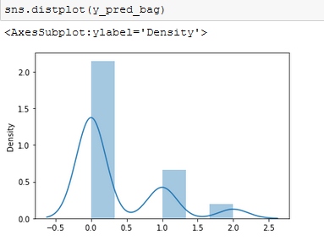
NORMALIZED CONFUSION MATRIX AND ACCURACY

Slide 17
Thank You

